Slide 1
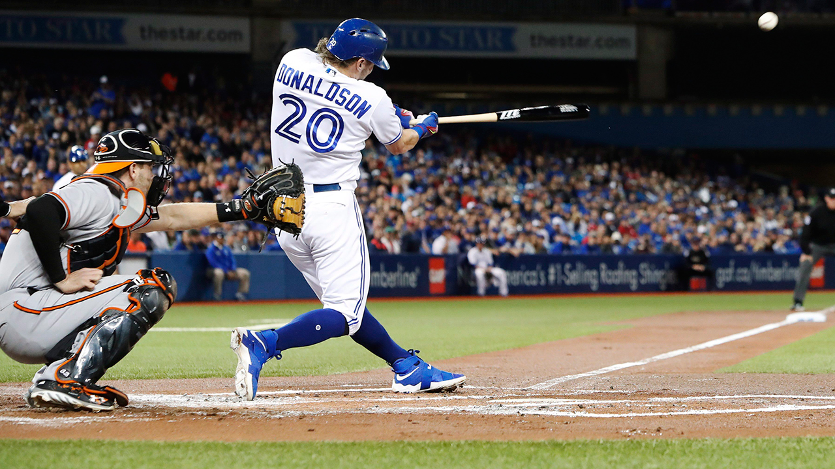
Źródło zdjęcia: sportsnet.ca
Wojciech Krakowiak

Slide 2
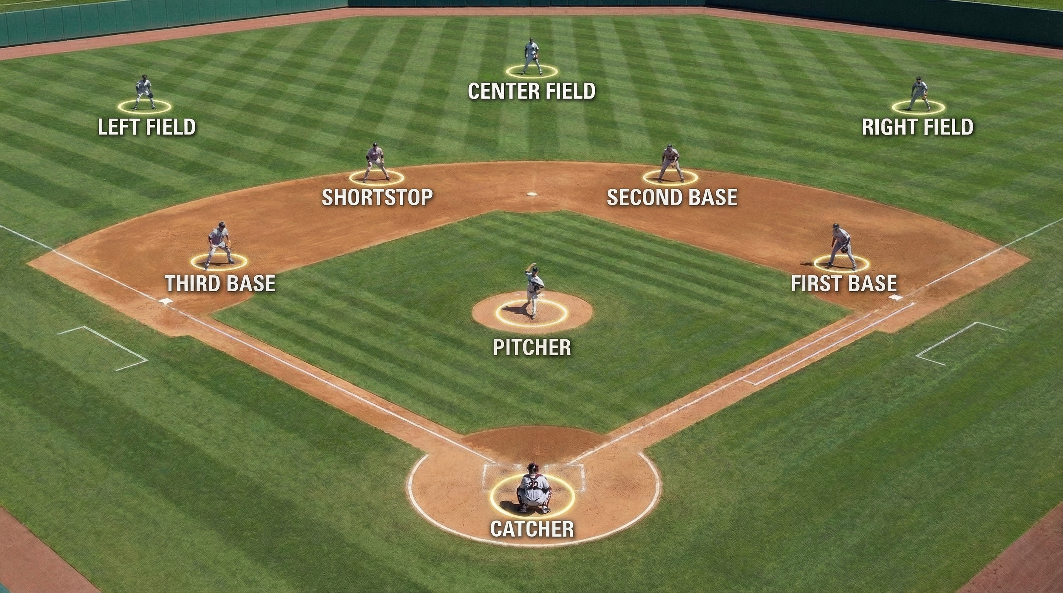
Basics of baseball
In baseball the distance between the batter and the pitcher is 60ft
In baseball the ball is thrown straight at the batter and
The area of play in baseball is a diamond-shaped field in front of the batter
Roles rotate once three outs are reached
Źródło zdjęcia: allathletscub.com

Slide 3
RULES OF BASEBALL
Teams: 2 teams of 9 players each
Objective: Score runs by hitting the ball and running around 4 bases to reach home plate
Innings: A game consists of 9 innings; each team gets one turn at bat per inning
Outs: A batting team continues until 3 outs are made.
Pitching and Hitting: A pitcher throws the ball to the batter, who tries to hit it
Runs: A run is scored when a player runs around all bases and returns to home plate
Strikes and Balls: A batter is out after 3 strikes; 4 balls earns a walk (free base)
Fielding: The fielding team tries to get batters out by catching the ball, tagging runners, or forcing them out at bases
Home Run: A ball hit over the outfield fence in fair territory scores an automatic run (and any runners on base)
Źródło zdjęcia: sportsnet.ca

Slide 4
MAJOR TOURNAMENTS
1. Major League Baseball (MLB) – USA & Canada
2. World Baseball Classic (WBC)
3. Nippon Professional Baseball (NPB) – Japan
4. KBO League – South Korea

